Slide 1
Advanced Front-End Programming (CPAN 144)
Week 4
Lecturer: Harshdeep Singh
Summer 2024

Slide 2
Agenda
React Components
Introduction to JSX
React Element

Slide 3
Let's create a new React App!
In the upcoming activity, we are going to create a react app and create all required files/components manually:
create-react-app my-app
cd my-app
npm start

Slide 4
Components
React apps are made out of components.
A component is a piece of the UI (user interface) that has its own logic and appearance.
A component can be as small as a button, or as large as an entire page.

Slide 5
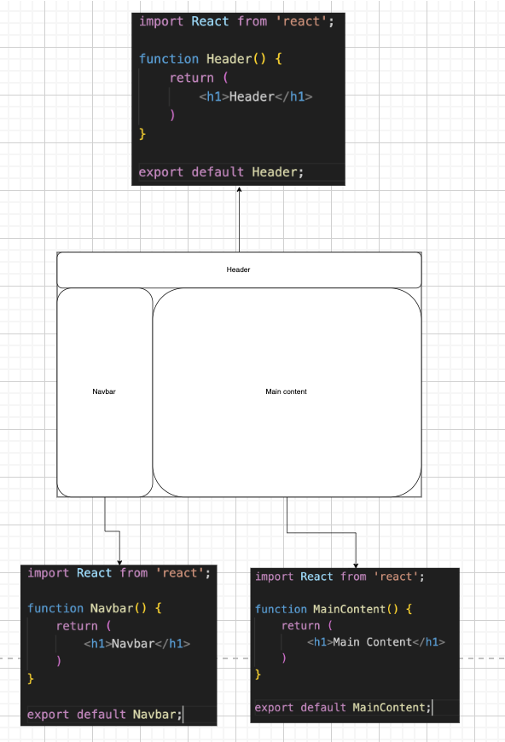
Components (visualized)

Slide 6
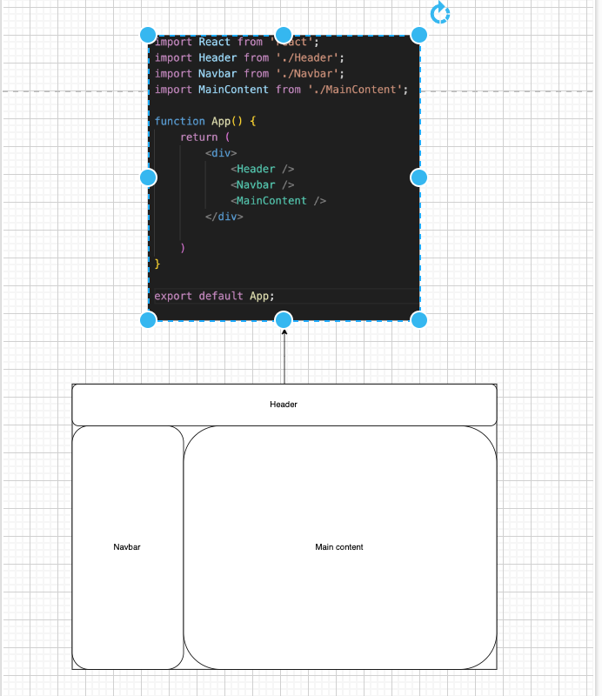
Components (visualized)

Slide 7
Activity
Let’s try to mimic this layout in React!

Slide 8
Components
Notice that <App />, <Header />, <Navbar /> and <MainContent /> all start with a capital letter. That’s how you know it’s a React component. React component names must always start with a capital letter, while HTML tags must be lowercase.

Slide 9
Importing and Exporting Components
The magic of components lies in their reusability: you can create components that are composed of other components.
But as you nest more and more components, it often makes sense to start splitting them into different files.
This lets you keep your files easy to scan and reuse components in more places.

Slide 10
Function Components

Slide 11
What is a function component?
The simplest way to define a component is to write a JavaScript function.
Most common way of implementing a component in react.
Is a plain JavaScript function that returns JSX.

Slide 12
Function component
App.js
function App() {
return (<h1> … </h1>)
}

Slide 13
Class Component

Slide 14
Creating a Class Component
Before React 16.8, Class components were the only way to create React component.

Slide 15
How to create a Class Component
The component must include the extends React.Component statement, this statement creates an inheritance to React.Component, and gives your component access to React.Component's functions.
The component also requires a render() method, this method returns HTML.

Slide 16
Example – Class Component
class Car extends React.Component {
render() {
return <h2>Hi, I am a Car!</h2>;
}
}

Slide 17
Create a Class Component
The component must include the extends React.Component statement
The component also requires a render() method, this method returns HTML.
class App extends React.Component {
render() {
return <h2>Here I am!</h2>;
}
}

Slide 18
Class Component
Although class components are still supported in React, it is not recommended to create class components in new React code

Slide 19
JSX : JavaScript XML
(and why we want to use it)

Slide 20
React Elements
Before learning about JSX, it makes sense to learn about the thing it replaced, React Elements

Slide 21
React Elements
Elements are the smallest building blocks of React apps.
An element describes what you want to see on the screen:

Slide 22
React Elements
This would create an <h1> tag on the browser screen with the text ‘Hello world’

Slide 23
React Elements
This is totally valid React code, and you can still write your code like this, but it has some shortcomings

Slide 24
React Elements
This code is less readable than writing HTML-like code that we wrote earlier
For simpler elements, this is manageable, but problem arises when we start combining multiple elements

Slide 25
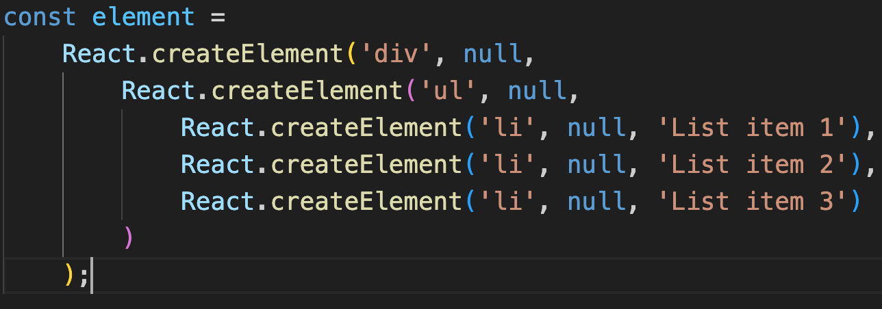
createElement code:

Slide 26
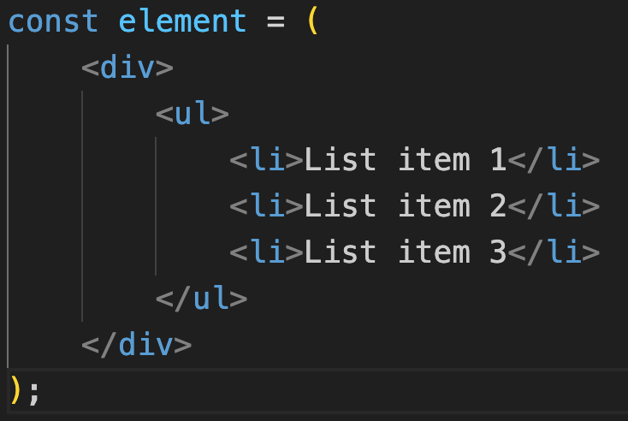
JSX code:

Slide 27
Introduction to JSX
JSX is a syntax extension for JavaScript that lets you write HTML-like markup inside a JavaScript file.
Is used to create react elements

Slide 28
Introduction to JSX – Cont.
Although JSX follows markup syntax like HTML, it comes with its own set of rules that are stricter than HTML

Slide 29
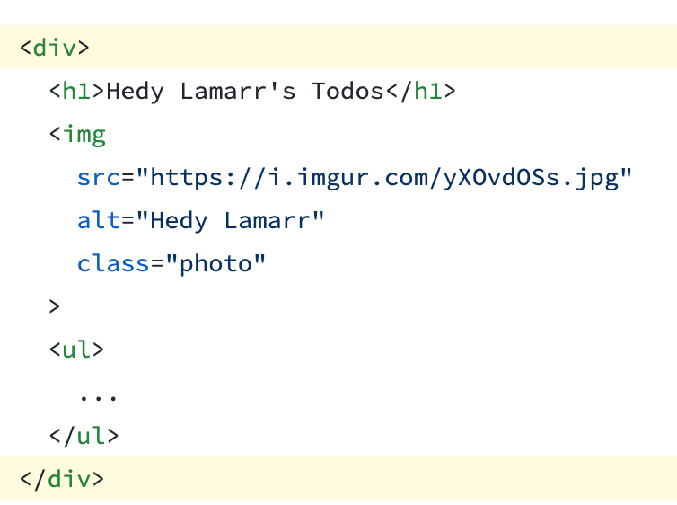
Rules of JSX – Return a single root element
To return multiple elements from a component, wrap them with a single parent tag.
For example, you can use a <div>:

Slide 30
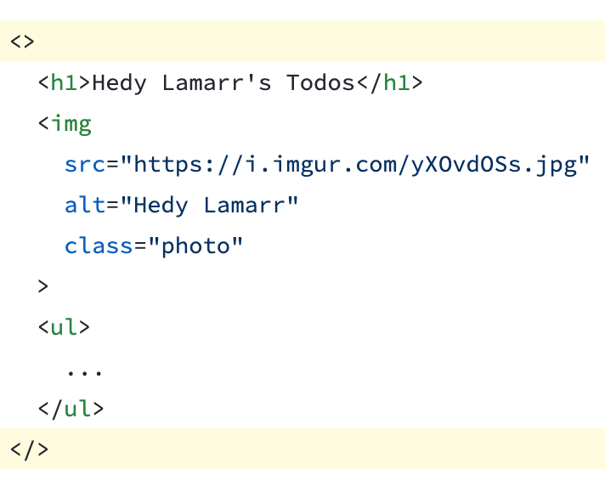
Rules of JSX – Return a single root element
If you don’t want to add an extra <div> to your markup, you can write <> and </> instead:

Slide 31
Rules of JSX – Close all the tags
JSX requires tags to be explicitly closed: self-closing tags like <img> must become <img />, and wrapping tags like <li>oranges must be written as <li>oranges</li>

Slide 32
Rules of JSX – camelCase most of the things!
Most attributes and properties in HTML that are separated with dashes(eg. stroke-width, background-color) must be converted to camel case syntax in JSX(strokeWidth, backgroundColor etc.)

Slide 33
Rules of JSX – camelCase most of the things!
Also note that in HTML, we define class to a tag like:
But in JavaScript, class is a reserved keyword, to accommodate that we must write JSX classes with the keyword className. So the above example would be written in JSX as:

Slide 34
Pro-tip: Use a JSX Converter
Converting all these attributes in existing markup can be tedious!
It is recommended to use a converter to convert your valid HTML to JSX syntax
https://transform.tools/html-to-jsx

Slide 35
Expressions in JSX
Sometimes you will want to add a little JavaScript logic or reference a dynamic variable inside that markup.
With JSX, you can write expressions inside curly braces { }.
The expression can be a React variable, property, or any other valid JavaScript expression.
const myelement = <h1>React is {5 + 5} times better with JSX</h1>;

Slide 36
Example
function getGreeting(user) {
if (user) {
return <h1>Hello, { formatName(user)}!</h1>;
}
return <h1>Hello, Stranger.</h1>;
}

Slide 37
Submit your class Activities
Navigate to Course Content -> Assessments -> Labs -> Lab 4 and download the instruction for lab 4.
Once you fulfill all the requirements of the lab, ZIP all your source files and submit them into Course Content -> Assessments -> Labs -> Lab 4
Pay attention to the due date defined on the blackboard submission box for this activity.

